Slide 1

Introduction to Management
Chathuranga Adhikari
B.com (Sp)(Hons), M.com

Slide 2

Learning outcomes
Understand the nature of management and basic elements of management.
Key components in management definitions.
Identification of basic management functions and the importance of those functions.

Slide 3

What is an Organization?
It is a group of people working together in a structured and coordinated fashion to achieve a set of goals.
A legal entity that involves several people attempting to accomplish specific objectives is depicted as an organization. It is additionally viewed as a thought of organizing things practically that will help accomplish pre-defined goals.

Slide 4

Who is a Manager?
A manager is someone whose primary responsibility is to carry out the management process.
A manager is a person who plans and makes decisions, organizes, leads, and controls human, financial, physical, and information resources.
Someone who coordinates and oversees the work of other people so organizational goals can be accomplished.

Slide 5
Resources of an Organization
Human resources
Financial resources
Physical resources
Information resources

Slide 6

What is Management?
Resource-based perspective – Describes how managers combine and coordinate the various kinds of resources.
“A set of activities (including planning and decision making, organizing, leading and controlling) directed at an organization’s resources (human, financial, physical and information), with the aim of achieving organizational goals in an efficient and effective manner”.
Ricky W. Griffin – Management Principles and Practices

Slide 7
What is Management?
Management in all business and organizational activities is the act of getting people together to accomplish desired goals and objectives using available resources efficiently and effectively.
“Management is the art of getting things done through others.” –
Mary Parker Follet.
“Management is knowing exactly what you want to do and then seeing that they do it the best and cheapest ways.” - F W Taylor.

Slide 8

Why Management?

Slide 9
Nature and Characteristics of Management
Management is a Universal Process
Applied in all types of institutions – social, religious, political, military, commercial, bureaucratic, etc.
Every organization whose aim is to achieve its goals through group efforts needs planning, coordination, direction, and control – Management
Management is a goal-oriented
Management is directed toward achieving effectiveness and efficiency.
Effectiveness is nothing but the actual achievement of specific organizational goals while Efficiency is the attainment of those goals with an optimal use of resources.

Slide 10
Nature and Characteristics of Management
Management is a social process
Management basically deals with managing human beings and their emotions, talents, attitudes, culture, ethos, education, etc.
Management includes retaining, developing, and motivating people at work, as well as taking care of their satisfaction as social beings.
Management is a coordinating force
An orderly arrangement of activities to avoid duplication and overlapping.
Integrates human and physical resources.

Slide 11
Nature and Characteristics of Management
Management is intangible
Management cannot be touched and felt.
It does not have a physical presence (It is an unseen force).
Management is multi-disciplinary
Management has received rich contributions from various disciplines like psychology, sociology, anthropology, etc.
Management is about creating synergy (Synergy means “the whole is greater than the sum of its parts”).
Management is dynamic
Management is an ongoing process, it continues to operate as long as there is organized action for the achievement of group goals.

Slide 12
Nature and Characteristics of Management
Management is a creative activity
Management provides creative ideas and new imagination
Management is decision-making
The management of an organization continuously makes decisions that decide the fate of the organization.
Management is a profession
Individuals can be trained and turned to become management professionals.

Slide 13
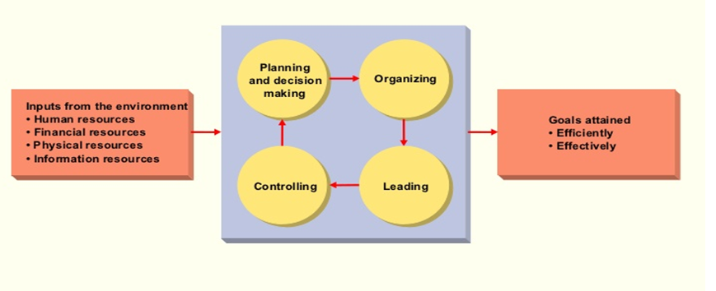
Management in Organizations
Management Process
8/12/24

Slide 14
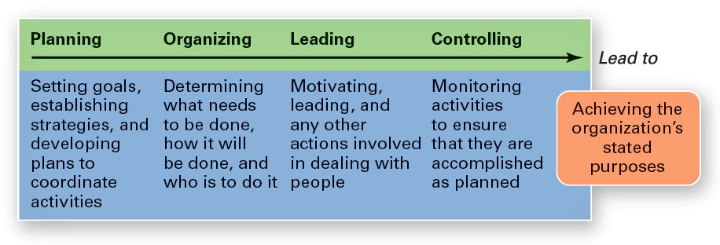
Management Process

Slide 15

Efficiency and Effectiveness
Efficiency
Getting the most output for the least inputs
Doing things right
Effectiveness
Attaining Organizational goals
Doing the right thing

Slide 16
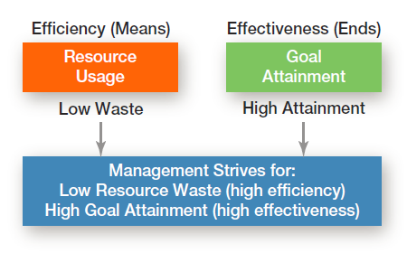
Efficiency & Effectiveness in Management

Slide 17
Kinds of Managers
Managers at different levels of the organization
Managers in different areas of the organization
Marketing Managers
Finance Managers
Operations Managers
Human Resources Managers
Administration Managers
Other Managers
Top Managers
Middle Managers
First – line Managers

Slide 18
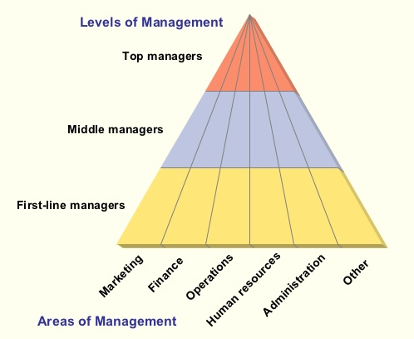
Kinds of Managers Cont…

Slide 19
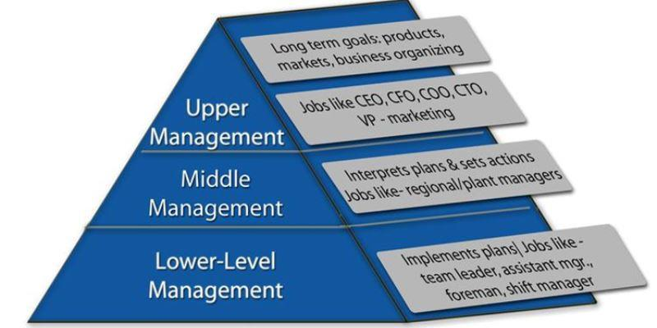
Level of Management

Slide 20
Top Managers
A small group of executives.
Manage the overall organization.
Establish the organization’s goals, overall strategy, and operating policies.
Officially represent the organization to the external environment.
Make key decisions on investments, marketing, research and development, etc.
Work long hours.
Spend more time in meetings and discussions.
E.g: President, Vice President, Chief Executive Officer (CEO)

Slide 21
Middle Managers
A large group of managers.
Responsible for implementing the policies and plans developed by top managers.
Supervise and coordinate the activities of lower-level managers
E.g: Plant manager, operations manager, division head

Slide 22
First-Line Managers
Supervise and coordinate the activities of operating employees.
Spend more time for supervising subordinates.
E.g: Supervisor, Coordinator, office manager

Slide 23

Kinds of Managers by Area
Marketing Managers – Managers who work in areas related to the marketing function.
E.g: Product development and promotion, sales and distribution
Financial Managers – Managers deal with organizations financial resources.
E.g: Accounting, cash management and investments
Operations Managers – Managers who create and manage the systems that create an organization’s products and services.
E.g: Production control, Quality control and inventory control

Slide 24
Kinds of Managers by Area
Human Resources Managers – Managers who are responsible for hiring and developing employees.
E.g.: Human resources planning, selection and recruiting, planning designing, and implementing human resources development
Administrative Managers – Managers who are responsible for all managerial activities of an organization.
E.g.: They tend to have some basic familiarity with all functional areas of management.
Other Kinds of Managers – Other managers who were appointed according to the requirements of an organization.
E.g: Client Relations Manager, Research and Development manager, Credit Manager

Slide 25
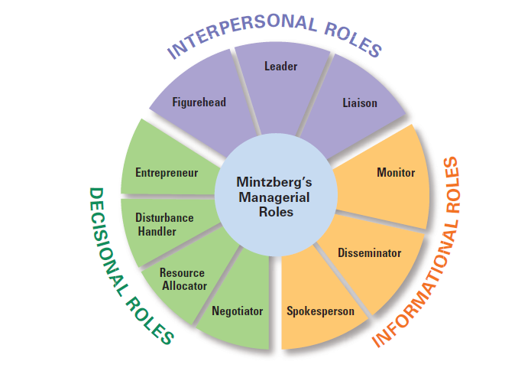
Managerial Roles
Specific actions or behaviors expected of and exhibited by a manager

Slide 26

Managerial Skills Type
Conceptual Skill
Ability to think in the abstract, the ability to analyze the forces working in a situation, creative and innovative ability.
Technical Skill
Managers' understanding of the nature of the job that people under them have to perform.
Human Relation Skills
Ability to interact effectively with people at all levels.

Slide 27
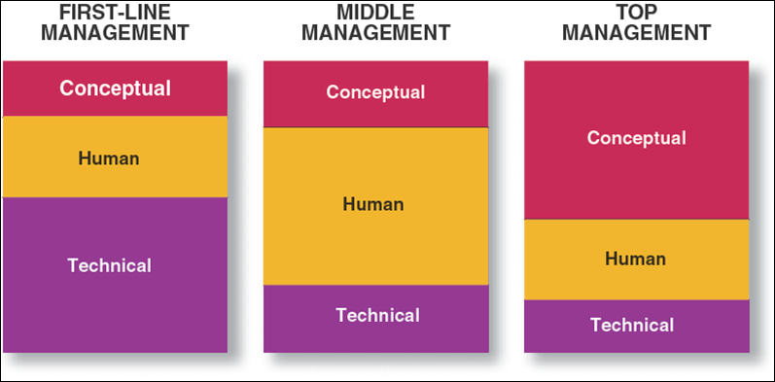
Managerial Skills at Different Management Levels

Slide 28

Importance of Management
Management has been important to the daily lives of people and to the organizations. The importance of management may be traced to the following.
Effective Utilization of Resources
Development of Resources
It ensures continuity in the organization
Integrating various interest groups
Stability in the society

Slide 29
Thank you!

